Slide 1
Peer-to-Peer Lending Platform Analysis: Predicting Default Among Subprime Borrowers

Slide 2
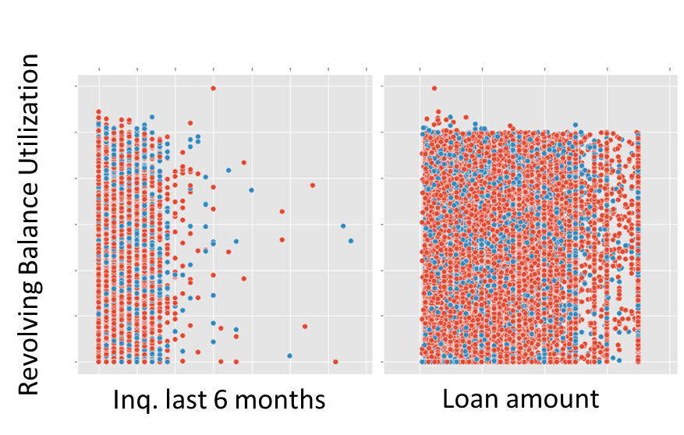
Predicting Loan Default Among Subprime Borrowers
Peer-2-Peer Lending platforms bring borrowers and investors together to offer an alternative mechanism for borrowers to access to credit to get on the path to financial health
This practice tends to enrich for higher risk borrowers in the marketplace
Platform: Lending Club Loan data is composed of largely subprime borrowers
Lending Club loan dataset demonstrates higher risk/subprime borrowers do indeed fully repay loans (default rate of 15%)
Traditional predictors of credit worthiness (i.e. years of credit history, income, debt to income ratio, employment length, number of accounts) do not strongly correlate with default in this dataset → alternative modeling may be required for this population
Project: develop model that can predict default among subprime borrowers
Impact: Analysis and modeling of this dataset can provide more accurate, data-driven characterization of modern subprime borrowers that are denied by traditional lenders.
Predicting default will reduce loss to investors, improve portfolio performance, generate more profits to reinvest into the marketplace.
Predict default among higher risk borrowers is useful to all loan granting institutions. Subprime modeling can expand the customer base for traditional banks and improve performance in subprime loan granting institutions (automotive, rent-a-center, payday loans)

Slide 3
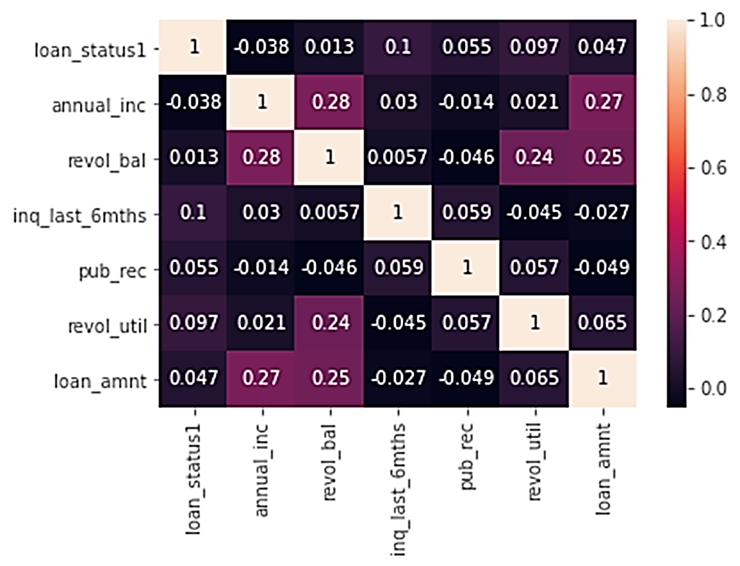
Lending Club Dataset analysis and model generation
Lending Club Dataset Overview:
Number of loans/Variables: 42,536/144
Period: 06-2007 through 11-2011
Default Rate: 15.12%
Imbalanced data
The goal of this model is to predict the likelihood that a customer will default before any parameters that define the terms of the loans are determined. That includes important parameters such as: Interest rate and terms/maturity period
Tools: Data management and modeling were conducted in Python
Techniques:
Synthetic Minority Oversampling Technique (SMOTE):
To address imbalanced between defaulted and non-defaulted loans
Note: SMOTE-NC for model alternatives that include categorical variables
Variable Selection: Correlation matrix, judgement,
Training and Testing Subsets
Logistic Regression: For a bivariate classification problem
Alternative Models
Using Probability threshold
Receiver Operating Curve (ROC curve)
Variable Selection: Correlation Matrix

Slide 4
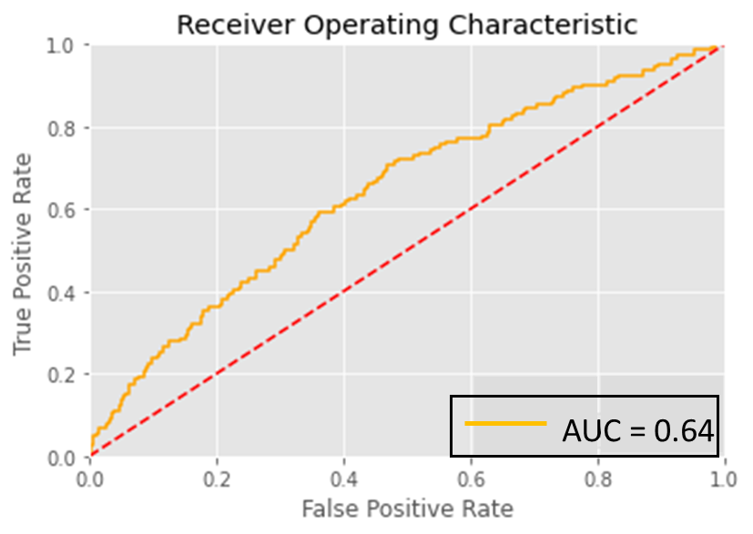
Loan Default Model Evaluation
Evaluation Using Test Set: 990 loans
 | Paid Off | Charged Off
Loan Counts | 846 | 144
Precision | 92% | 20%
Recall | 52% | 72%
F1 Score | 0.66 | 0.31
Next Steps:
Include FICO score to improve model performance

